Slide 1
Reference Model: Supply Planning
Architecture Training
Industry Solutions

Slide 2
Contents
Modules Overview
Basic Master Planning Module
Extending/Customizing The Ref Model
Additional Master Planning Modules
Order Planning Module

Slide 3
Modules Overview
Module 1: Basic Master Planning
  Forecast Netting
  Demand Prioritization
  Plan Generation
  Pegging & Root Causing
Module 2: Incremental & Interactive Planning (for Master Planning)
Module 3: Scenario Management (for Master Planning)
Module 4: Financials (for Master Planning)
Module 5: Order Planning
Documentation URL: http://10.0.1.210/SupplyRefModel/

Slide 4
Contents
Modules Overview
Basic Master Planning Module
Functional Overview
Model: Dimensions
Function Deep Dive
Model: Rules Overview
Model: Plans/MeasureGroups
Extending/Customizing The Ref Model
Additional Master Planning Modules
Order Planning Module

Slide 5
Basic Master Planning: Functional Overview
The basic master planning module has the following functions
  Network Creation
  Network Validation
  Forecast Netting
  Demand Prioritization
  Plan Generation
  Pegging & Root Causing
The default configuration is set for weekly planning buckets

Slide 6
Basic Master Planning: Dimensions Overview
Time
SCSItem
SCSResource
SCSResourceGroup
SCSLocation
SCSDemand
SCSDemandType
SalesAccount
SCSActivity1
SCSActivity2
SCSActivity3
SCSDocuments
SCSSupplier
SCSPriorityType
ItemClassification
CustClassification
CustomerClass
SCSItemCustomerClass
Used For Demand Prioritization
‘Core’
Plan Generation
Tenant
Used For Powershell plugin integration

Slide 7
Basic Master Planning: Dimensions
Only fiscal calendar modelled
FiscalMonth in terms of 4-4-5 Fiscal Weeks
Hierarchy
FiscalYear
FiscalQuarter
FiscalMonth
FiscalWeek
Day
Time
Models the items (parts) – raw materials, finished goods, sub assemblies etc…
Has multiple hierarchies
Primary: ItemHierarchy
Others: ProductHierarchy, ProductTypeHierarchy, StageHierarchy
Primary Hierarchy ItemHierarchy
ItemGroup
ItemSubGroup
Item
SCSItem
Standard members are ‘FinishedGoods’, ‘RawMaterials’, ‘SubAssemblies’. Most reports are filtered to run off these members

Slide 8
Basic Master Planning: Dimensions
Models all locations (sites)
Hierarchies:
Primary: LocationHierarchy
Primary Hierarchy LocationHierarchy
All
LocationGroup
Location
SCSLocation
Standard members are ‘Plant’. ‘DC’, ‘RDC’. Most reports are filtered to run off these members
Models the customer accounts (e.g. Customer IDs) and/or channels, markets etc…
This model is shared with DemandPlanning
Hierarchy
AccountGroup6
AccountGroup5
…
AccountGroup1
Account
SalesAccount

Slide 9
Basic Master Planning: Dimensions
Models all resources
Hierarchies:
Primary: ResourceHierarchy
Primary Hierarchy ResourceHierarchy
All
ResourceGroup
Resource
SCSResource
Models groups of simultaneous resources
Hierarchy
AccountGroup6
AccountGroup5
…
AccountGroup1
Account
SCSResourceGroup

Slide 10
Basic Master Planning: Dimensions
Models individual demand line items
Every individual demand intersection gets a unique DemandID
Hierarchy
DemandClass
DemandGroup
DemandID
SCSDemand
Models the various layers (types) of demand after forecast netting:
COM_ORDER
NEW_ORDER
UNF_ORDER
COM_FCST
NEW_FCST
COM_BUF
NEW_BUF
No hierarchy
DemandType
SCSDemandType

Slide 11
Basic Master Planning: Dimensions
The activities/operations in the supply network (i.e. manufacturing, distribution or procurement operations) are represented/specified by a combination of 3 Attributes. The example below explains:
Attribute1
Attribute2
Attribute3
Mfg Activity
BOM ID
Routing
Produced Item
Dist Activity
Dist Lane ID
Transportation Mode
Produced Item
Proc Activity
Supplier
Transportation Mode
Procurement op ID

Slide 12
Basic Master Planning: Dimensions
The 3 Attributes explained in the previous slide are modelled in the following 3 SCSActivity dimensions.
Models BOM IDs, BOD (Distribution) Lanes
For procurement operations the Supplier names are filled in here.
No Hierarchy
ActivityType1
Activity1
SCSActivity1
Models Routings and transportation modes (for both distribution and procurement operations)
No Hierarchy
ActivityType2
Activity2
SCSActivity2
Models procurement operation IDs.
For manufacturing and distribution operations, the (produced) items are filled in here
No Hierarchy
ActivityType3
Activity3
SCSActivity3

Slide 13
Basic Master Planning: Dimensions
Models all supply transaction IDs
Purchase Order IDs (actually line item IDs)
Mfg Order IDs
Delivery/Transportation Order IDs
Stock On Hand (standard ID: OnHand)
No Hierarchy
DocumentType
OrderLineID
SCSDocuments
Models the suppliers and their locations
The supplier locations are also automatically created in the SCSLocation dimension by the reference model during the CreateNetwork workflow
Hierarchy
Supplier
SupplierLocation
SCSSupplier

Slide 14
Contents
Modules Overview
Basic Master Planning Module
Functional Overview
Model: Dimensions
Function Deep Dive
Model: Rules Overview
Model: Plans/MeasureGroups
Extending/Customizing The Ref Model
Additional Master Planning Modules
Order Planning Module

Slide 15
Key Functions
Network creation
Forecast netting
Demand prioritization
Plan generation (solver)
Supportability analytics
Root Cause reporting
Inventory plans
Capacity plans

Slide 16
Basic Master Planning: Network Creation
Primary Function
Construct the static supply network from ‘raw’ input
Key Inputs
Items, Locations
BOMs, Routings (Manufacturing)
BOD (Distribution) Lanes, Transportation Modes (Distribution)
Suppliers, Inbound Lanes/Transportation Modes
Key Outputs
Network inputs to solver
Logic
Two active rules files ActiveRule_02.Routing Rules and ActiveRule_03. BOD Rules have some rules related to processing the input data files into intermediate data
CreateNetwork IBPL procedure file has all the logic to convert the input measures (e.g. BOM) to the final network representation required by the solver
Currently network creation logic deletes and recreates the entire network. An incremental version is planned for the next release

Slide 17
Basic Master Planning: Forecast Netting
Primary Function
Netting (Consumption) of sales orders against forecasts
Key Inputs
Forecasts
Sales Orders
RTF (previous commits to forecasts)
Key Outputs
Segmented demand
    Netted forecasts
    Committed forecasts
    New forecasts
    Sales Orders
    Committed orders
    Unforecasted orders

Slide 18
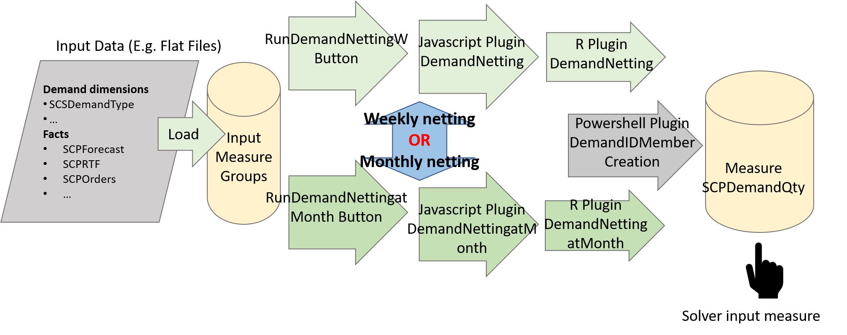
Basic Master Planning: Forecast Netting
Logic
There are two variants available: Netting forecasts at monthly level, netting forecasts at weekly level.
The logic is described in the figure below

Slide 19
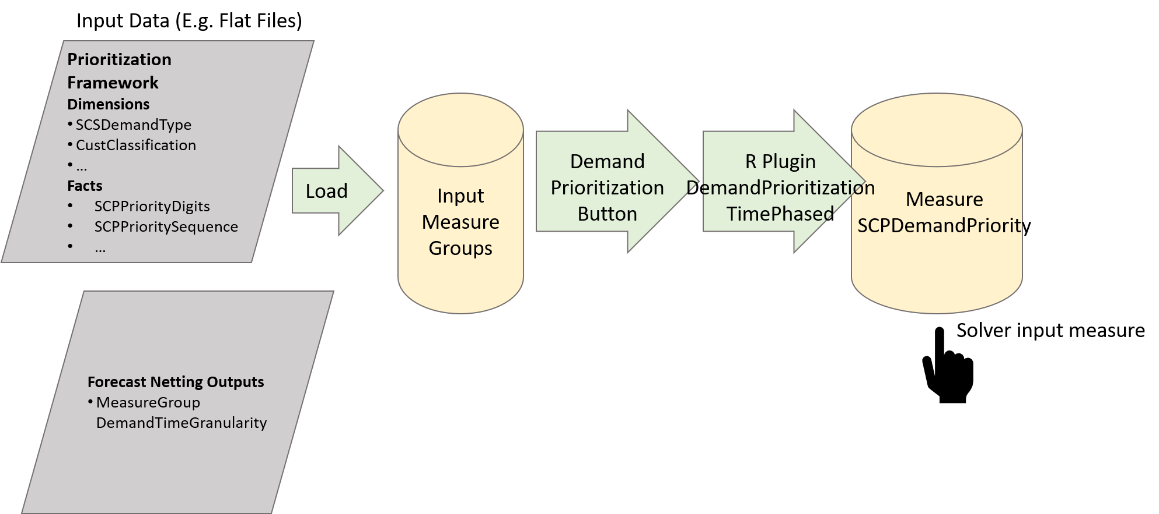
Basic Master Planning: Demand Prioritization
Primary Function
Create numeric priority value for every demand ID
Key Inputs
Demand (SCPDemandQty) grained by SCSDemand.DemandID and SCSDemandType.DemandType (output of Forecast Netting)
Key Outputs
Measure SCPDemandPriority (this is an input to the solver)

Slide 20
Basic Master Planning: Plan Generation
Primary Function
Generate a constrained master plan
Key Inputs
Demand (in the DemandTimeGranularity measure group)
Network data output of CreateNetwork (multiple measures)
Supply data – On Hand inventory, Purchase Orders, WIP etc… <<ref>>
Plan parameters (multiple) <<ref >>
Key Outputs
Solver output measures
Demand fulfilment plans
Production plans
Distribution plans
Procurement plans
Peggings
Root Cause peggings

Slide 21
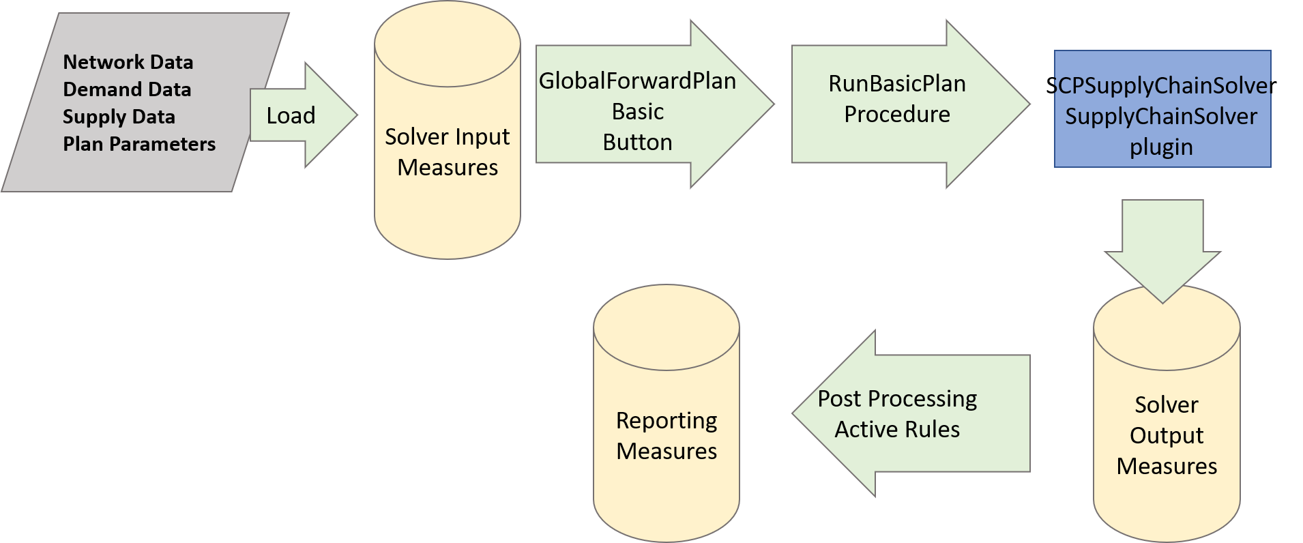
Basic Master Planning: Plan Generation
Logic
The solver plugin is SCPSupplyChainSolver
The logic flow for invoking a plan is shown below

Slide 22
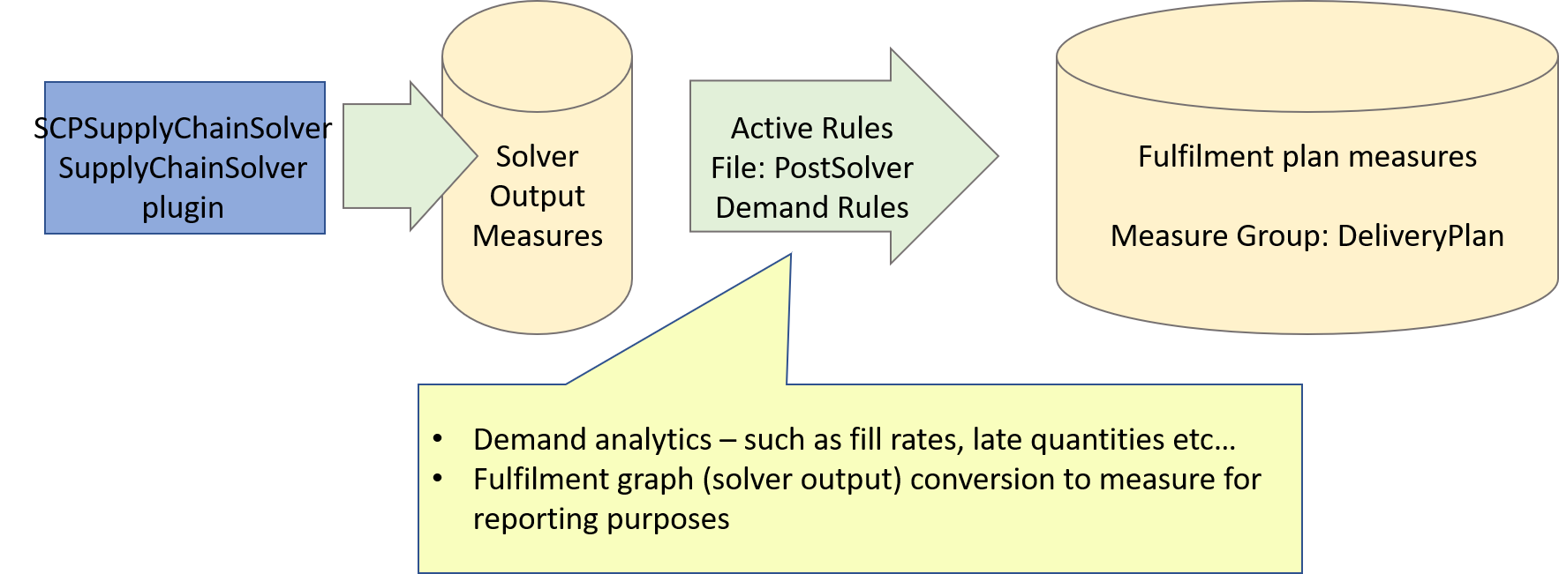
Basic Master Planning: Plan – Supportability Analytics
Primary Function
Analytics for supply commits to demands
Key Inputs
Solver fulfilment graph output
Key Outputs
Measure Group: DeliveryPlan (multiple measures)

Slide 23
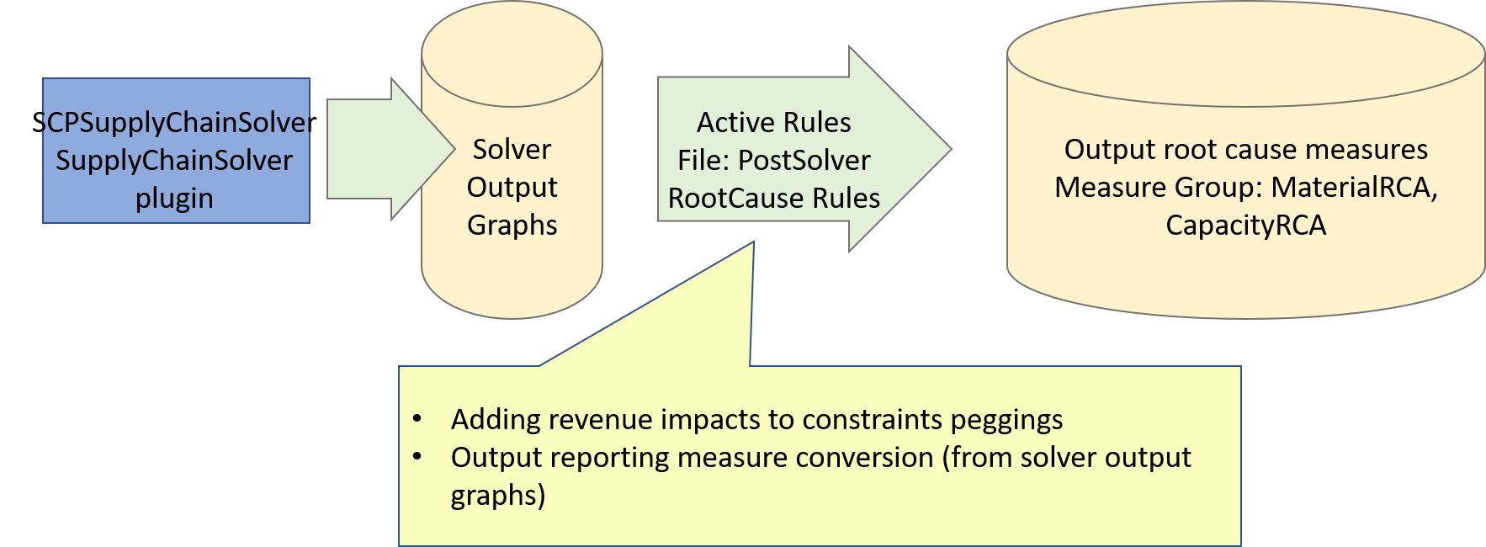
Basic Master Planning: Plan – Root Cause Reporting
Primary Function
Constraint root cause reporting
Key Inputs
Solver peggings – additive and pegging RCA graphs
Key Outputs
Solver peggings – additive and pegging RCA graphs
Reporting measures – Measure groups: MaterialRCA, CapacityRCA

Slide 24
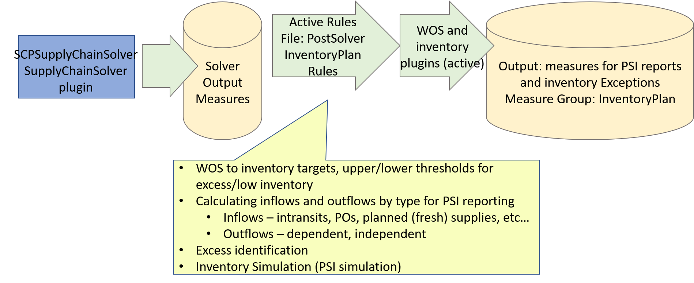
Basic Master Planning: Plan – Inventory Plan
Primary Function
Inventory plan (PSI) reports
Inventory Exception reporting
Key Inputs
Solver inventory plans – beginning and ending on hand profiles
Solver material peggings
Key Outputs
Measure Group: InventoryPlan

Slide 25
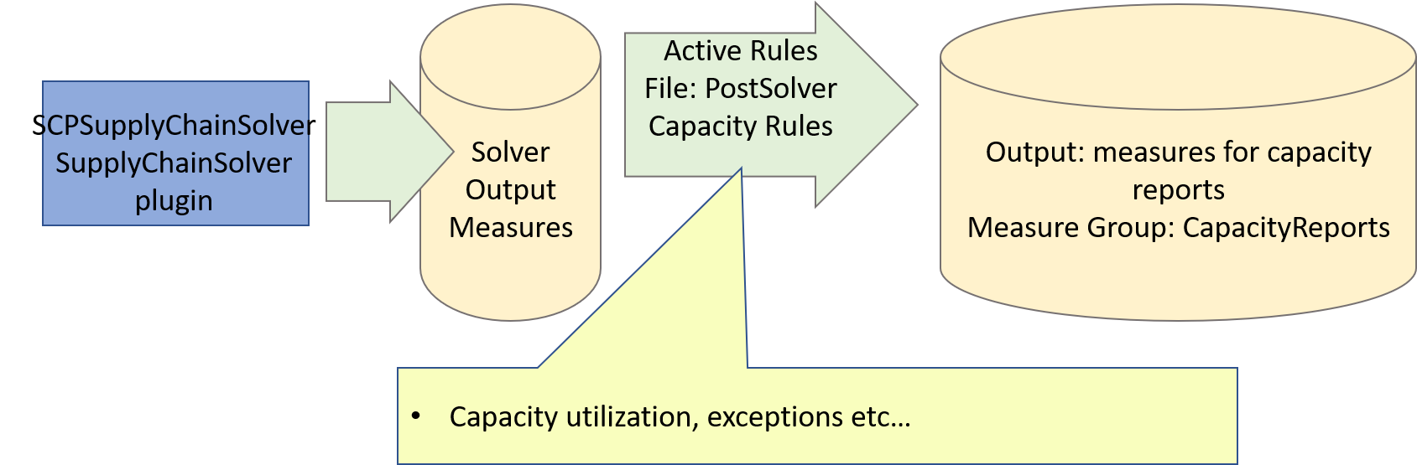
Basic Master Planning: Plan – Capacity Plan
Primary Function
Capacity Utilization reports
Capacity Exception reporting
Key Inputs
Solver capacity plans – base and flex capacity usage
Solver capacity peggings
Key Outputs
Measure Group: CapacityReports

Slide 26
Contents
Modules Overview
Basic Master Planning Module
Functional Overview
Model: Dimensions
Function Deep Dive
Model: Rules Overview
Model: Plans/MeasureGroups
Extending/Customizing The Ref Model
Additional Master Planning Modules
Order Planning Module

Slide 27
Basic Master Planning: Rules Overview
Function | Active Rules | Buttons | IBPL Procedures | Plugins
Create Network | ActiveRule_02.Routing Rules ActiveRule_03. BOD Rules | CreateNetworkProcedure | CreateNetworkPreUploadFiles CreateNetworkPostUploadFiles
Forecast Netting (Monthly) | RunDemandNettingatMonth | RunDemandNettingatMonth |  | o9.referencesupplyplanning.DemandNettingatMonth (JavaScript) DemandNettingatMonth (R) o9.referencesupplyplanning.DemandIDMemberCreation (Powershell)
 | RunDemandNettingW | RunDemandNettingW |  | o9.referencesupplyplanning.DemandNetting (JavaScript) DemandNetting (R) o9.referencesupplyplanning.DemandIDMemberCreation (Powershell)

Slide 28
Basic Master Planning: Rules Overview
Function | Active Rules | Buttons | IBPL Procedures | Plugins
Demand Prioritization |  | RunDemandPriorityW |  | DemandPrioritizationTimePhased (R)
Supply Input Data | ActiveRule_04. WIP and Inventory Input Rules
Plan Parameters | ActiveRule_05. Frozen Window Calculations
Plan Generation |  | GlobalForwardPlanBasic | RunBasicPlan | SCPSupplyChainSolver (Solver)
Demand Supportability | ActiveRule_06. PostSolver Demand Rules
Root Cause | ActiveRule_09. PostSolver Root Cause rules
Capacity Reports | ActiveRule_08. PostSolver Capacity Rules
Inventory Plans | ActiveRule_07. PostSolver Inventory Plan Rules

Slide 29
Contents
Modules Overview
Basic Master Planning Module
Extending/Customizing The Ref Model
Additional Master Planning Modules
Order Planning Module

Slide 30
Extending/Customizing The Ref Model
General Principles/Objectives
Core solver input/output should be required on rare occasions only.
Upgrade processes should be easy – e.g. there’s a new version of the Ref Model that has a more performant functionality.
Traceability and version control in the tenant configuration process, including customizations/extensions.

Slide 31
Extending/Customizing The Ref Model
Methodology
Keep all customized/extended config elements separate from Ref Model
E.g. ‘I don’t want to use the Ref Model’s demand fulfilment analytics, I have my own rules.
Create a copy of the PostSolver_Demand Rules active rule file – let’s call it ‘My Demand Rules File’
Make changes in My demand Rules File – delete the relevant Ref Model rules, add your own rules.
Delete the Ref Model PostSolver_Demand Rules file.
Maintain a ‘Diff’ log: Basically a script that should be able to reconstruct your tenant from a new Ref Model package download.
E.g.
Step 1: Delete PostSolver_Demand Rules file.
Step 2: Add the My Demand Rules file.

Slide 32
Extending/Customizing The Ref Model
Methodology
Utilize DDLs and similar mechanisms as much as possible. To allow programmatic creation of a tenant
Maintain a DDL file to create as many entities as possible – e.g. All measures should be in a DDL file. You can then apply version control on this file.
Use the Industry Solutions Rule Creator app for Active Rule file creation. You can then apply version control on Rules files

Slide 33
Appendix

Slide 34
Version Log
Version | Date | Author | Notes
1.0 | 17 Apr | Siddhartha Niyogi | First version

Slide 35
Basic Master Planning: Plans & Measure Groups Overview
Plan | Key Measure Group | Primary Function
SupplyPlanning | DemandTimeGranularity

